Slide 1
Personal Webpage using HTML
Name: Mehak Mittal
Branch: CSE
Year: 2nd year
Semester: 3rd
Sec: C
University Roll.no.: 2300290100152

Slide 2
Project Overview
Objective: To create a personal webpage that highlights my skills, my passion for web development and a brief description about me.
Key Features:
Clean and modern design.
Multiple sections for easy navigation.
A brief bio
A profile picture
Links to social media accounts
About section

Slide 3
Tech Stack
Languages: HTML, CSS
Styling: Custom CSS for layout and design.
Assets: Images and icons for a personalized touch.

Slide 4
Page Structure
Header: Contains the navigation menu with links to various sections (Home, About, Skills, Education, Interests, Contact).
Main Section: Hero section with a brief introduction, profile picture, and social media links.
Social Media Links:
LinkedIn
Twitter
GitHub
Telegram
About Me Section
Introduction:
Passionate about creating efficient and user-friendly websites.
Education:
Pursuing B.Tech CSE from KIET Group of Institutions.
Interests:
Exploring new technologies, reading, and creative writing.

Slide 5
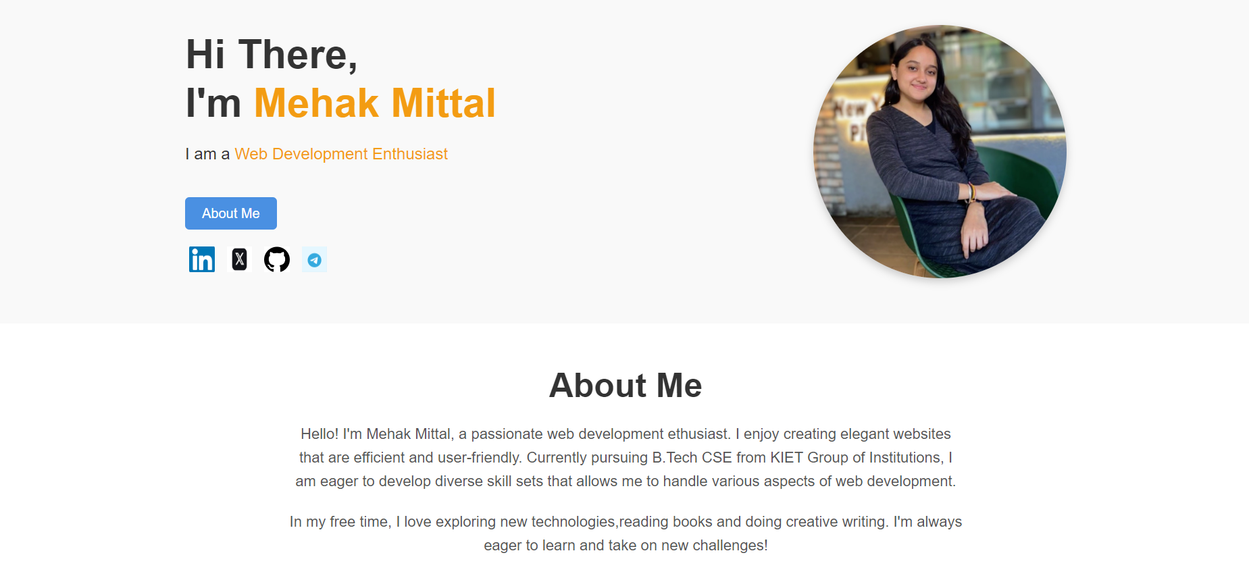

Slide 6
Conclusion
In conclusion, this personal webpage using html is a reflection of my journey as a web development enthusiast, showcasing my passion for creating elegant and user-friendly websites. Through this platform, I aim to share my skills, experiences, and the knowledge I continue to gain in the ever-evolving field of web development .
I believe that a well-crafted online presence not only highlights my capabilities but also serves as a gateway for connecting with like-minded individuals and potential collaborators. I am excited about the opportunities that lie ahead and look forward to engaging with a wider audience through my work.
Thank you for your attention! I welcome any questions or feedback you may have.

